Slide 1
Functions in MySql

Slide 2
What is User Defined Function
A User Defined Function is a set of SQL statements that can be called by another SQL statement.
While using MySQL database, we can come across a situation where we have to write the same code again and again. In that case, we can define functions where we will write that piece of code and call that user-defined function based on our needs. In that case, we can use User-defined functions

Slide 3
Syntax
CREATE FUNCTION function_Name(input_arguments) RETURNS output_parameter
Where, function_name is the name of the function you need to create, input_arguments are the input values of the function and output_parameter is the return value of the function.

Slide 4
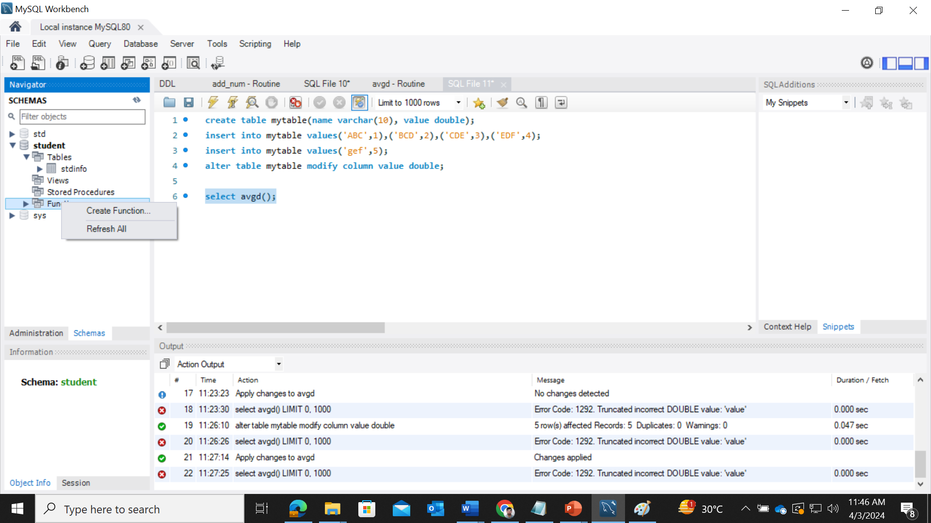
Create Function in MySql Workbench

Slide 5
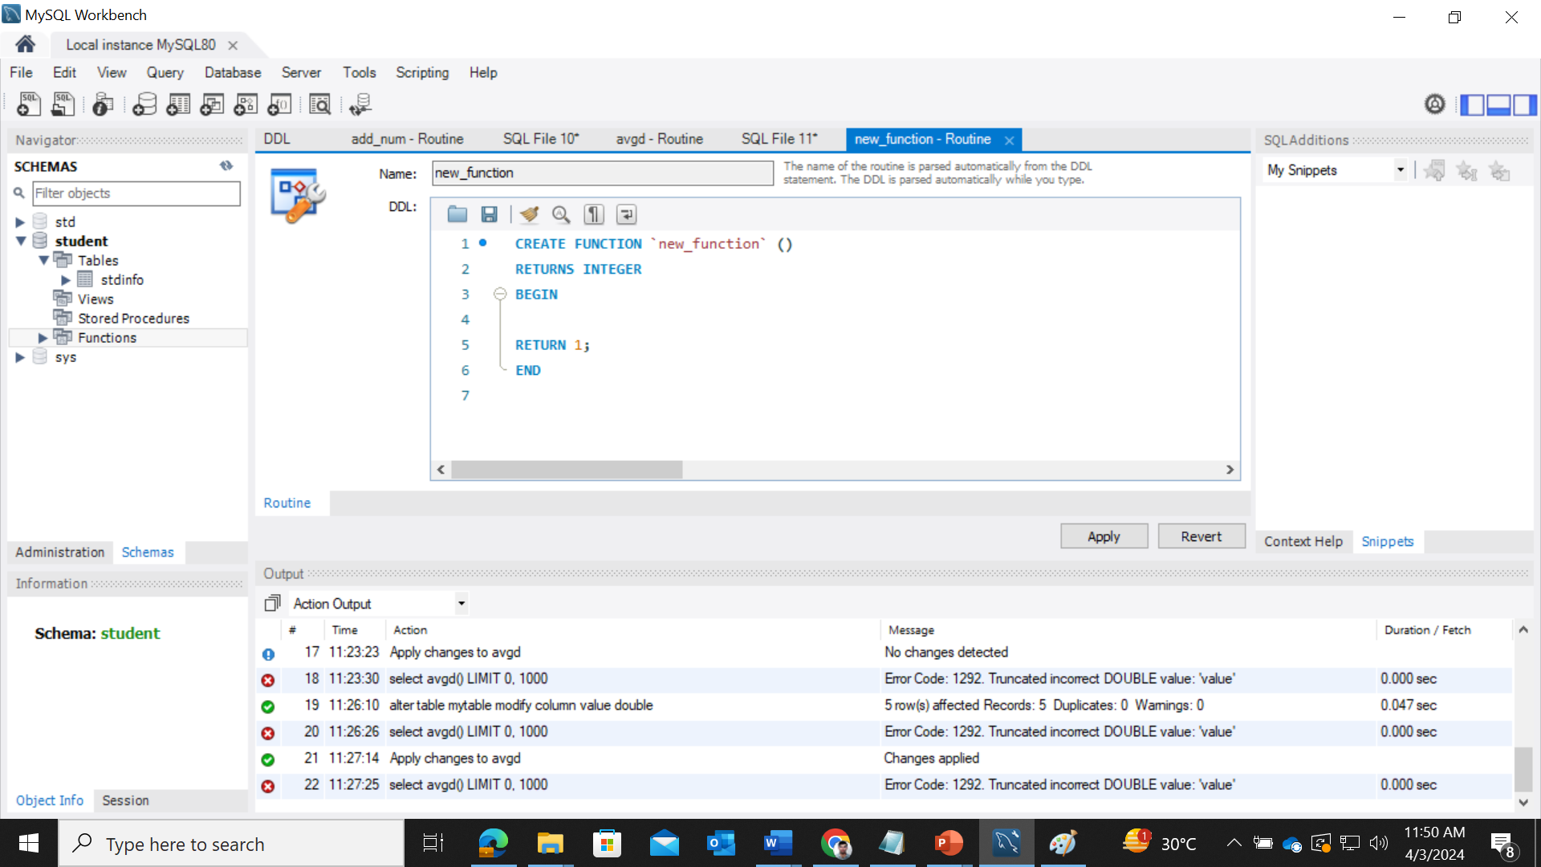

Slide 6


Slide 7
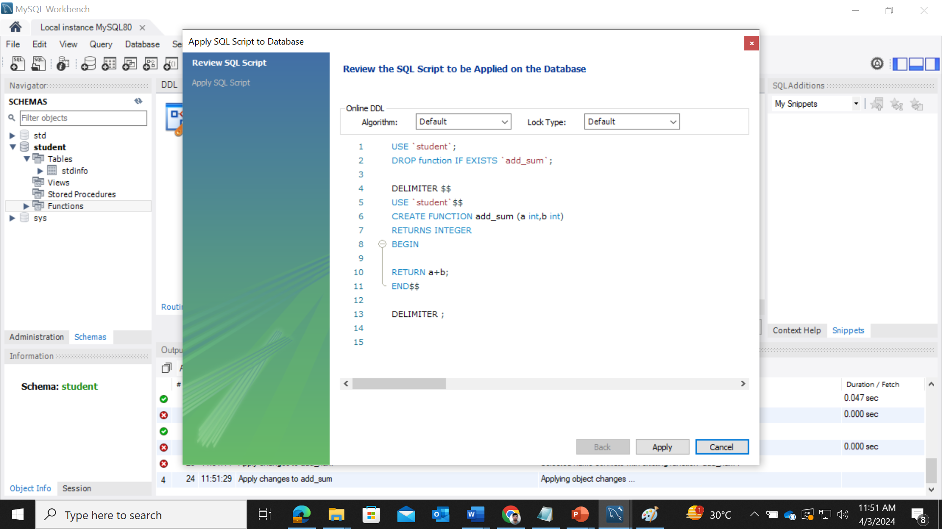

Slide 8
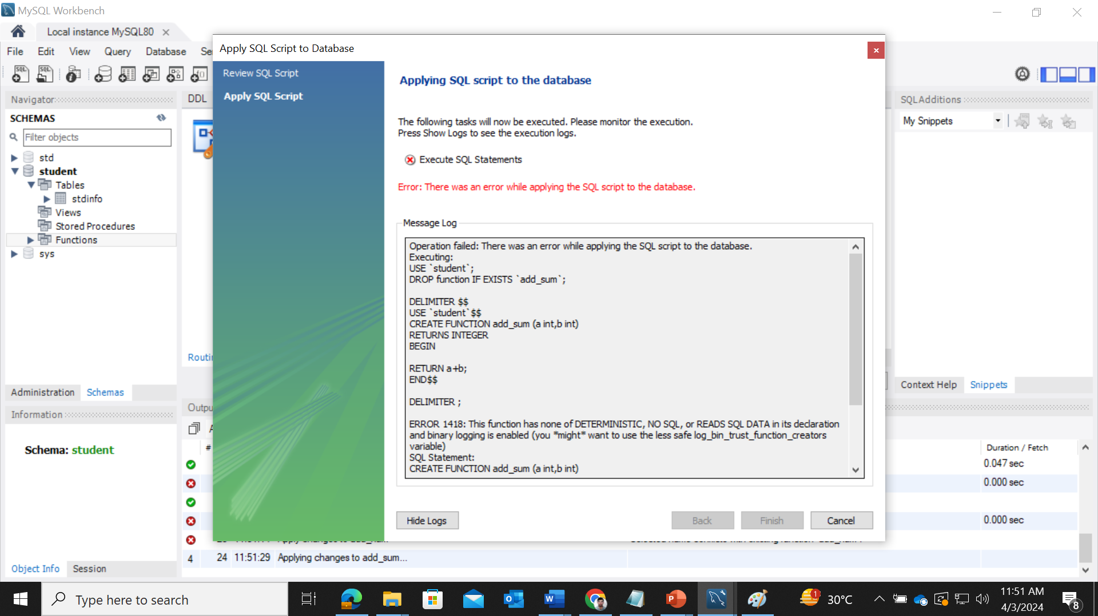

Slide 9
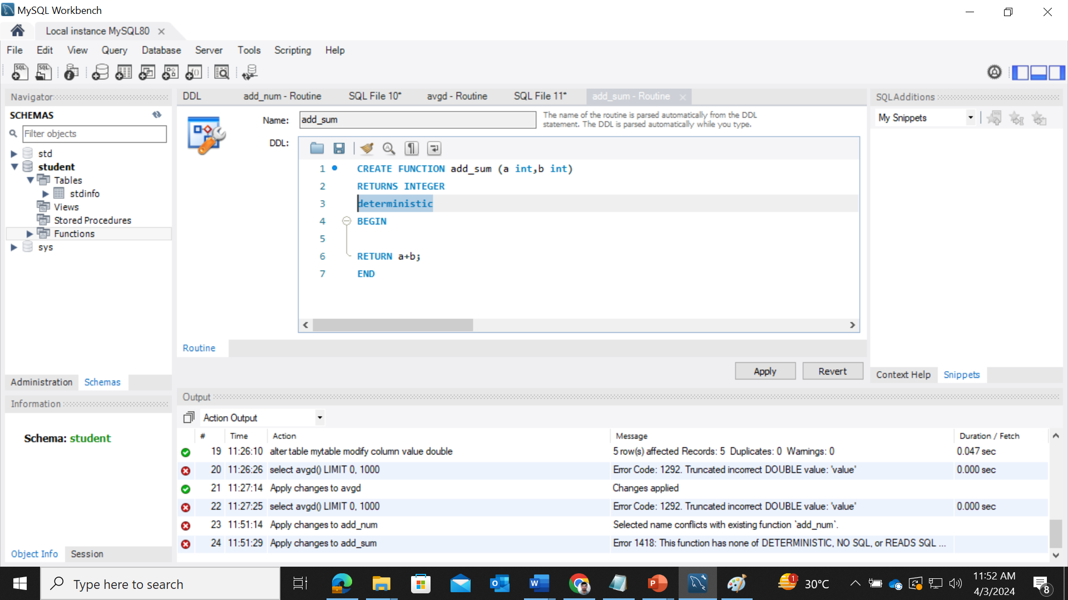

Slide 10
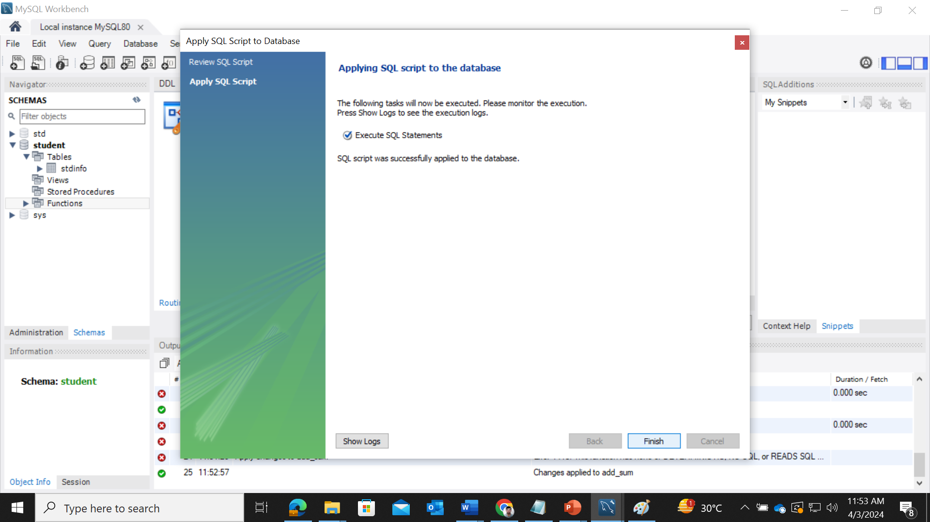

Slide 11
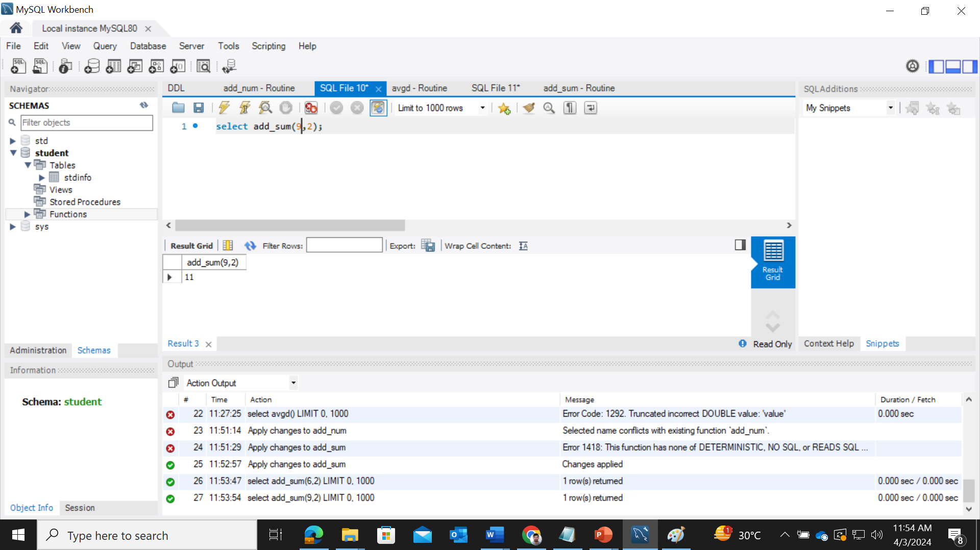
Call Function

Slide 12
Example
CREATE TABLE Emp( Name VARCHAR(255), DOB DATE, Location VARCHAR(255) );
INSERT INTO Emp VALUES
('Amit', DATE('1970-01-08'), 'Hyderabad'), ('Sumith', DATE('1990-11-02'), 'Vishakhapatnam'), ('Sudha', DATE('1980-11-06'), 'Vijayawada’);

Slide 13
Example
CREATE FUNCTION test.getDob(emp_name VARCHAR(50))
RETURNS DATE
BEGIN
declare dateOfBirth DATE;
select DOB into dateOfBirth from test.emp where Name = emp_name; MySQL CREATE FUNCTION Statement
return dateOfBirth;
END//

Slide 14
Cont..
If you call the function you can get date of birth of an employee as shown below −
SELECT getDob('Amit');

Slide 15
Example
CREATE TABLE student (
Name VARCHAR(100),
Math INT,
English INT,
Science INT,
History INT );

Slide 16
Cont..
INSERT INTO student values
('Raman', 95, 89, 85, 81), ('Rahul' , 90, 87, 86, 81),
('Mohit', 90, 85, 86, 81),
('Saurabh', NULL, NULL, NULL, NULL );

Slide 17
Creates a function with name tbl_Update
Create Function tbl_Update(S_name Varchar(50), M1 INT, M2 INT, M3 INT, M4 INT)
RETURNS INT
BEGIN
UPDATE student SET Math = M1, English = M2, Science = M3, History = M4 WHERE Name = S_name; RETURN 1;
END //

Slide 18
Call Function
Select tbl_update('Saurabh',85,69,75,82);

Slide 19
Stored Procedure
The stored procedure is SQL statements wrapped within the CREATE PROCEDURE statement. The stored procedure may contain a conditional statement like IF or CASE or the Loops. The stored procedure can also execute another stored procedure or a function that modularizes the code.
MySQL supports the use of stored procedures, which group one or multiple SQL statements for reuse under a common name

Slide 20
Benefits of a Stored Procedure
Reduce the Network Traffic: Multiple SQL Statements are encapsulated in a stored procedure. When you execute it, instead of sending multiple queries, we are sending only the name and the parameters of the stored procedure.
Easy to maintain: The stored procedure are reusable. We can implement the business logic within an SP, and it can be used by applications multiple times, or different modules of an application can use the same procedure. This way, a stored procedure makes the database more consistent. If any change is required, you need to make a change in the stored procedure only.
Secure: The stored procedures are more secure than the AdHoc queries. The permission can be granted to the user to execute the stored procedure without giving permission to the tables used in the stored procedure. The stored procedure helps to prevent the database from SQL Injection.

Slide 21
Syntax
Create Procedure [Procedure Name] ([Parameter 1], [Parameter 2], [Parameter 3] )
Begin
SQL Queries..
End
To execute the store procedure, you can use the CALL keyword. Below is syntax:
CALL [Procedure Name] ([Parameters]..)

Slide 22
Create a Stored Procedure
CREATE PROCEDURE sp_getemp()
BEGIN
select id,name,phone,email from employee;
END //

Slide 23
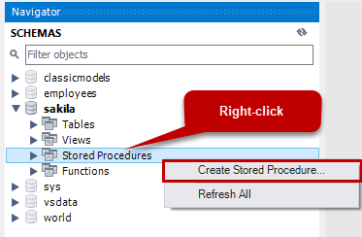
Crete procedure using MySQL workbench wizard

Slide 24
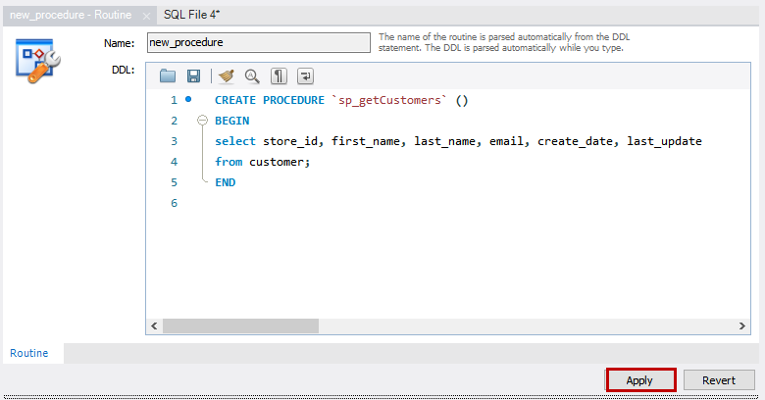

Slide 25
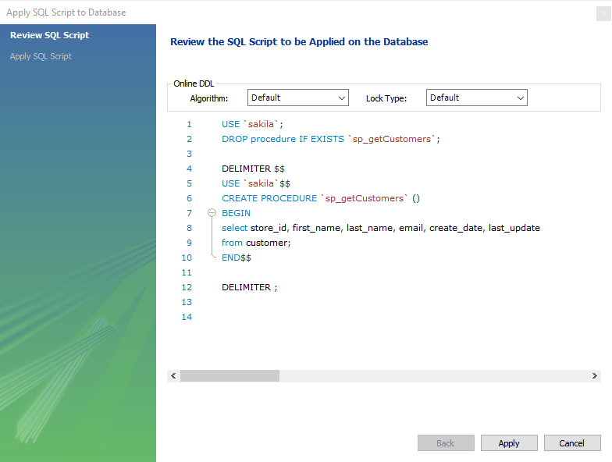

Slide 26
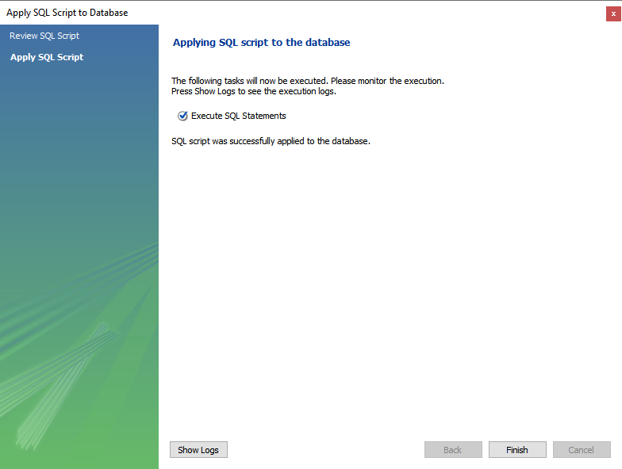

Slide 27
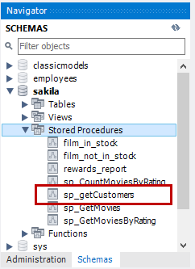

Slide 28
Create a Parameterized Stored Procedure
The MySQL Stored procedure parameter has three modes: IN, OUT, and INOUT. When we declare an IN type parameter, the application must pass an argument to the stored procedure. It is a default mode. The OUT type parameter, the stored procedure returns a final output generated by SQL Statements. When we declare the INOUT type parameter, the application has to pass an argument, and based on the input argument; the procedure returns the output to the application.

Slide 29
Example of IN Parameter
CREATE PROCEDURE sp_getemp(IN empid varchar(50))
BEGIN
select id,name,phoneno,email from employee where id=empid;
END //
CALL sp_getemp(‘101')

Slide 30
Example of OUT Parameter
CREATE PROCEDURE sp_countemp(OUT total_emp int)
BEGIN
select count(id) INTO total_emp from employee;
END //
To store the value returned by the procedure, pass a session variable named @countemp.
CALL sp_countemp(@countemp)
Select @countemp as EMP

Slide 31
Drop Stored Procedure
Drop procedure procedure_name

Slide 32
Example 1
CREATE TABLE studentMarks (stud_id SMALLINT(5) NOT NULL AUTO_INCREMENT PRIMARY KEY, total_marks INT, grade VARCHAR(5));
insert sample data
INSERT INTO studentMarks(total_marks, grade)
VALUES(450, 'A'), (480, 'A+'), (490, 'A++'), (440, 'B+’),
(400, 'C+'),(380,'C'),(250, 'D'),(200,'E'),(100,'F'),(150,'F'),(220, 'E');

Slide 33
Create and Call Stored Procedure
CREATE PROCEDURE GetStudentData()
BEGIN
SELECT * FROM studentMarks;
END
CALL GetStudentData();

Slide 34
With Input And Output Parameters
1) IN: IN Parameter is like a local function argument that we have in almost all programming languages like Java, C#, etc.
The IN parameters need to be passed along with the procedure call and are protected. What this means is that being protected is the value of the IN parameter can change during function execution but is retained once the execution flow is completed. i.e the changed value is local to the function execution
2) OUT: OUT Parameter is an OUTPUT parameter in which the procedure is supposed to return once the function execution is complete. The default value can be changed during procedure execution and returned back to the calling function or statement.
3) INOUT: INOUT is a combination of IN and OUT parameters. It can be optionally specified when the procedure is called and can be modified and returned back to the caller.

Slide 35
Example
CREATE PROCEDURE GetDetailsByStudentName(IN studentId INT)
BEGIN
SELECT * FROM studentMarks where stud_id = studentId;
END
Call GetDetailsByStudentName(1)

Slide 36
Example
CREATE PROCEDURE GetAverageMarks(OUT average DECIMAL(5,2))
BEGIN
SELECT AVG(total_marks) INTO average FROM studentMarks;
END //
But, here as we have an OUT parameter that would be returning a value, we can specify a placeholder prefixed by ‘@’
In this case, we have specified “@average_marks” which would hold the value of OUT parameter average as returned by the execution
Call GetAverageMarks(@average_marks);

